Slide 1
Understanding E-Commerce For Effective CRM
By Harshrajsinh Rathod

Slide 2
How do you analyse E-commerce?

Slide 3
Predictive Analytics
In the rise of E-commerce, predictive analytics is the crystal ball that estimates customer needs before the actual need arises.

Slide 4
Data 1st!

Slide 5
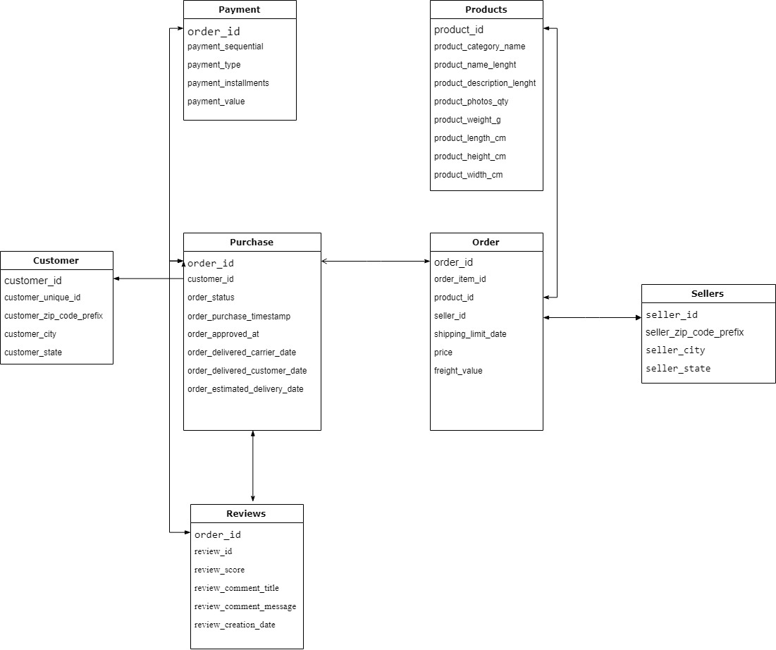

Data

Slide 6

Know your data!

Slide 7
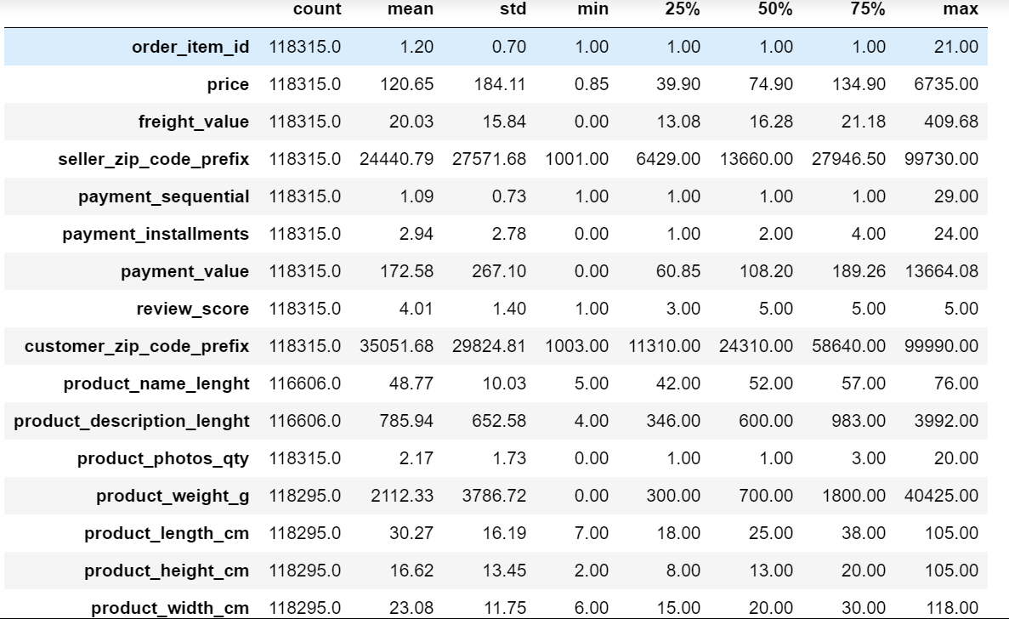
Descriptive Statistics

Slide 8

But, what about categorical data?

Slide 9
Ans: It depends.
Categories of attributes are analysed based on:
What What is the usefulness?
How How would it benefit Operational CRM?.

Slide 10

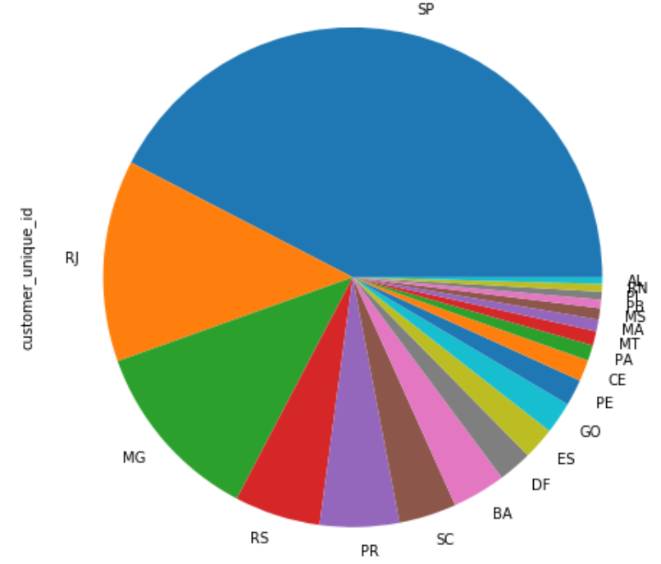
Know your customers.
From 27 states, more than half of the customers reside in Sao Paulo and Rio
From 95419 unique customers, only 2673 purchased twice and 240 returned for repeated purchases.
92506 is recurring business value lost as customer churn.
.

Slide 11
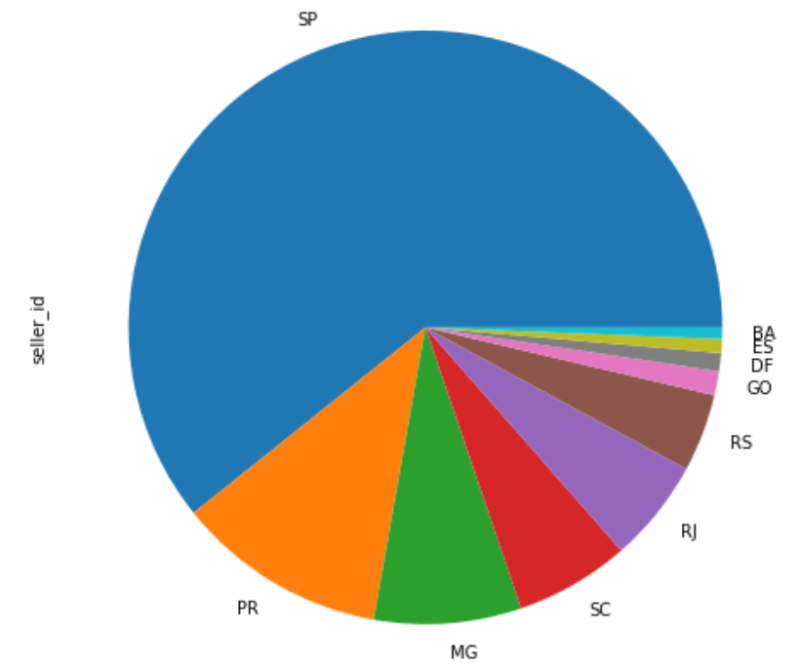

Know your sellers.
From 23 states, almost 2/3rd of the sellers come from Sao Paulo, followed by Paraná, Minas Gerais, Santa Catarina and Rio de Janeiro, total of which comprise almost 90% of the 3095 sellers.

Slide 12

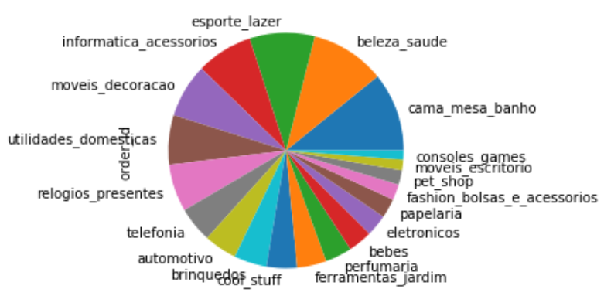
Most sold product is bed-bath-table, followed by sports-leisure, and home decorations etc.
Increased combo sales apply here for family & home oriented customers, as cross-selling or up-selling.

Slide 13

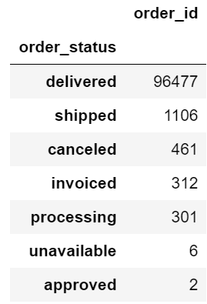
Deliveries count.
Deliveries made are significantly higher in comparison to minuscule cancelled orders or other processes.

Slide 14
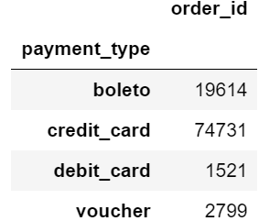
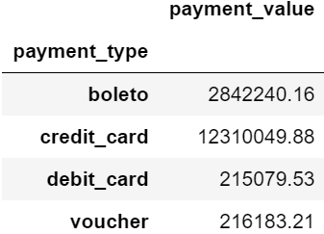


4 methods of payment within the country.
Highest paid through credit card
Boleto,for those who do not have a bank account, is second most popular payment method
Debit_card and voucher are less desirable payment methods.
Olist can collaborate with credit card companies to advertise and promote their brand for a charged fee.

Slide 15
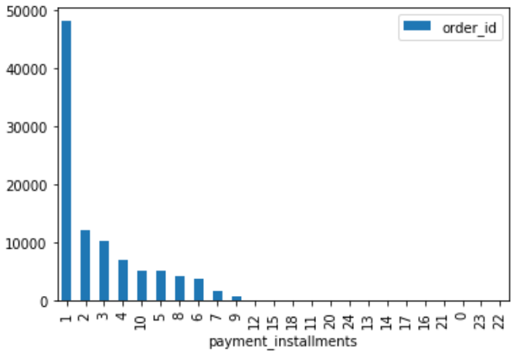
Most orders paid in one installment, possibly because only credit card payment allows more than one installment

Slide 16
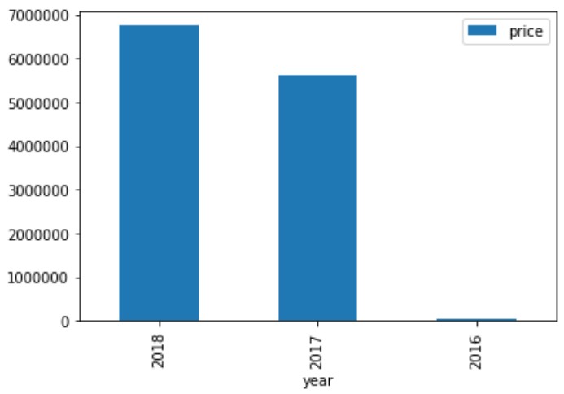
Milestones
Least orders
Increased sales
Highest orders
2016 | 2017 |  |  |  | 2018

Slide 17
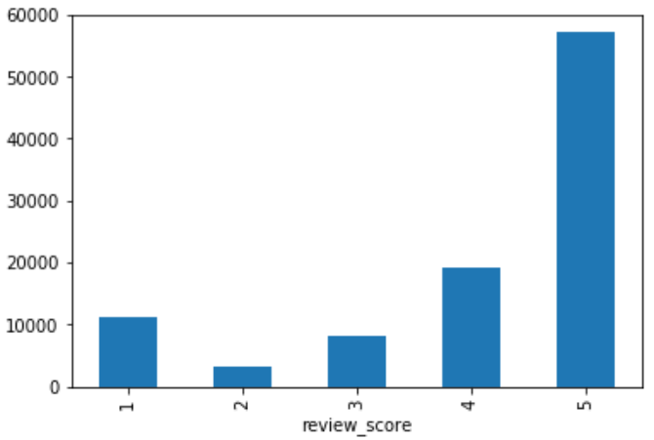
Most orders are highest rated!
Too good to be true!
No missing data for review_score, very suspicious.
This is real commercial data and most users don’t submit reviews.
Possibly, Olist released data mostly consisted of higher ratings by effort and not randomly by chance?

Slide 18
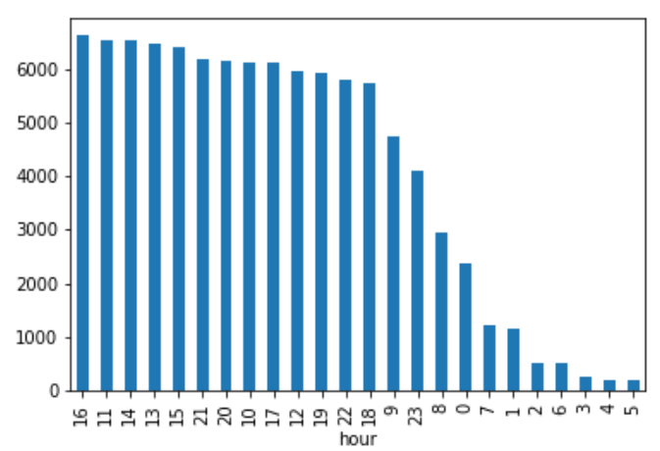
No orders from 12:00 a.m. to 8:00 a.m.
Rest of the day is very busy.
Peak hour is 16:00 for highest orders made, focus!

Slide 19
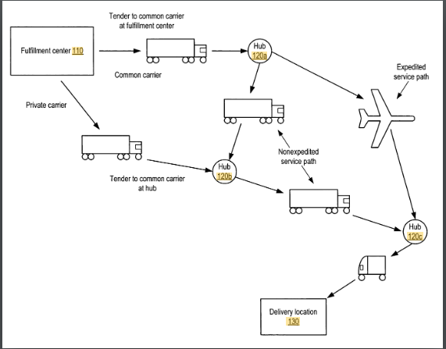
Patent by Amazon. No predictive algorithms mentioned! Amazon calls it ‘Anticipatory Shipping’.
"packaging one or more items for eventual delivery"
Fulfilment Centres, which can be Seller’s Distribution Centre or Amazon’s own.
In supply chain, not a new concept. Not unusual for manufacturer to ship products that sell more beforehand.
‘DC Bypass strategy’
Requires strong IT-enabled collaboration ties between manufacturer and retailers to accurately forecast.
Not easy, of course!
Future work

Slide 20
Farewell!

